Slide 1
C++ is Fun – Part 11 at Turbine/Warner Bros.!
Russell Hanson

Slide 2
Syllabus
1) First program and introduction to data types and control structures with applications for games learning how to use the programming environment Mar 25-27
2) Objects, encapsulation, abstract data types, data protection and scope April 1-3
3) Basic data structures and how to use them, opening files and performing operations on files – April 8-10
4) Algorithms on data structures, algorithms for specific tasks, simple AI and planning type algorithms, game AI algorithms April 15-17
Project 1 Due – April 17
5) More AI: search, heuristics, optimization, decision trees, supervised/unsupervised learning – April 22-24
6) Game API and/or event-oriented programming, model view controller, map reduce filter – April 29, May 1
7) Basic threads models and some simple databases SQLite May 6-8
8) Graphics programming, shaders, textures, 3D models and rotations May 13-15
Project 2 Due May 15
9) How to download an API and learn how to use functions in that API, Windows Foundation Classes May 20-22
10) Designing and implementing a simple game in C++ May 27-29
11) Selected topics – Gesture recognition & depth controllers like the Microsoft Kinect, Network Programming & TCP/IP, OSC June 3-5
12) Working on student projects - June 10-12
Final project presentations Project 3/Final Project Due June 12

Slide 3
Using the Virtual JoyStick and Keyboard directional controls with App Game Kit

Slide 4
8.3 Virtual Joysticks
What is a virtual joystick?
  A simulated joystick that you can display in your program and that the user can interact with
How many can you create?
  The AGK allows you to create up to 4 virtual joysticks
How do you use them?
  Virtual joysticks are controlled using the mouse or other pointing device

Slide 5
8.3 Virtual Joysticks
How do you add a virtual joystick?
  Call the agk::AddVirtualJoystick function
  Passing the following arguments:
    The index number you want to assign the virtual joystick
    The virtual joystick’s center X-coordinate
    The virtual joystick’s center Y-coordinate
    The virtual joystick’s size (diameter of a circle)
  For example:
    agk::AddVirtualJoystick(1,50,50,50);

Slide 6
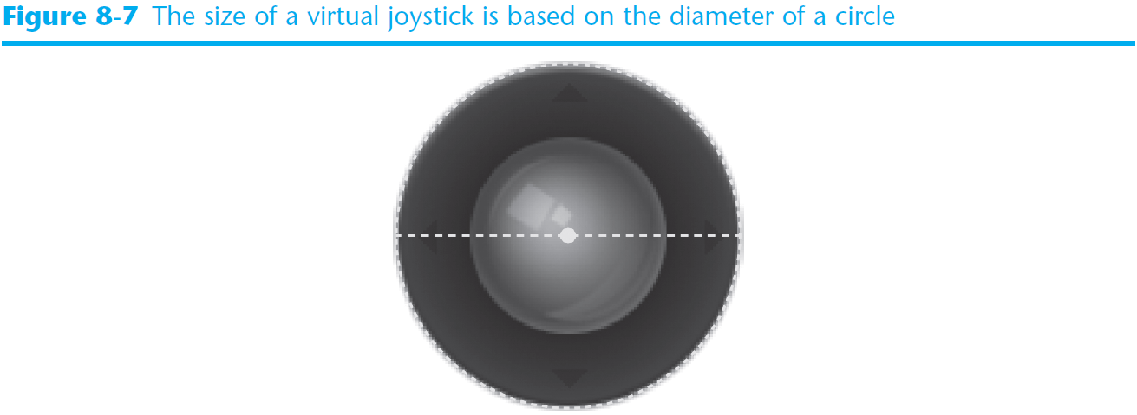

Slide 7
8.3 Virtual Joysticks
How do you change a virtual joystick’s position?
  Call agk::SetVirtualJoystickPosition
  Passing the following arguments:
    The virtual joystick’s index number
    The virtual joystick’s new center X-coordinate
    The virtual joystick’s new center Y-coordinate
  For example:
      agk::SetVirtualJoystickPosition(1,100,100);

Slide 8
8.3 Virtual Joysticks
How do you change a virtual joystick’s size?
  Call agk::SetVirtualJoystickSize Passing the following arguments:
    The virtual joystick’s index number
    The virtual joystick’s new size
  For example:
    agk::SetVirtualJoystickSize(1,200);

Slide 9
8.3 Virtual Joysticks
How do you change the transparency of a virtual joystick?
  Call agk::SetVirtualJoystickAlpha Passing the following arguments:
    The virtual joystick’s index number
    A value (0 – 255) for the alpha channel
  For example:
    agk::SetVirtualJoystickAlpha(1,255);

Slide 10
8.3 Virtual Joysticks
How do you enable / disable a virtual joystick?
  Call agk::SetVirtualJoystickActive
  Passing the following arguments:
    The virtual joystick’s index number
    A value indicating if the virtual joystick is to be active
      0 will set the virtual joystick as inactive
      1 will activate the inactive virtual joystick
    For example:
      agk::SetVirtualButtonActive(1,0);// disable
      agk::SetVirtualButtonActive(1,1);// enable

Slide 11
8.3 Virtual Joysticks
How do you hide or show a virtual joystick?
  Call agk::SetVirtualJoystickVisible
  Passing the following arguments:
    The virtual joystick’s index number
    A value indicating virtual joystick’s visibility
      0 will hide the virtual joystick (but it remains active)
      1 will show the previously hidden virtual joystick
    For example:
      agk::SetVirtualJoystickVisible(1,0);// hide
      agk::SetVirtualJoystickVisible(1,1);// show

Slide 12
8.3 Virtual Joysticks
How do you change a virtual joystick’s images?
  Make sure the images you want to use are located in the My Documents → AGK → template folder
  Load the new images and then call the following functions to apply the changes:
    agk::SetVirtualJoystickImageOuter
      Pass the index number of the virtual joystick
      Pass the index number of the virtual joystick’s outer image
    agk::SetVirtualJoystickImageInner
      Pass the index number of the virtual joystick
      Pass the index number of the virtual joystick’s inner image

Slide 13
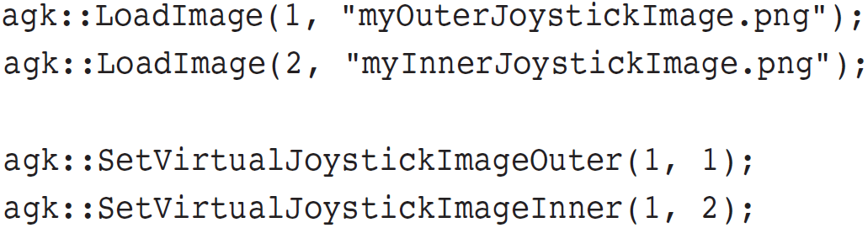
8.3 Virtual Joysticks
  Here is a summary of the steps you must take to change a virtual joystick’s images:
    Load the new inner and outer joystick images
    Set the virtual joystick’s new outer image
    Set the virtual joystick’s new inner image
  For example:

Slide 14
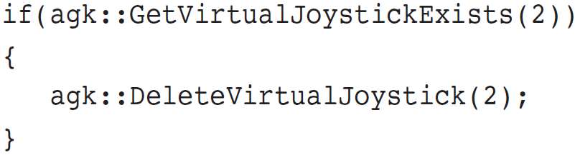
8.3 Virtual Joysticks
How do you delete an existing virtual joystick?
  Determine if the virtual joystick exists and delete it
    First, call agk::GetVirtualJoystickExists
      Passing the index number of the joystick you want to check
      Returns 1 if the joystick exists or 0 if it does not exist
    Then call agk::DeleteVirtualJoystick
      Passing the index number of the joystick you want to delete
    For example:

Slide 15
8.3 Virtual Joysticks
  What is a virtual joystick’s dead zone?
    Area around the joystick’s center that affects the distance you have to move the joystick before it registers input
  How do you change a joystick’s the dead zone?
    Call agk::SetVirtualJoystickDeadZone
      Passing the virtual joystick’s index number
      A floating-point value between 0 and 1for the dead zone
        A value of 0 would be very sensitive
        A value of 1 would totally disable the joystick
        The default value is 0.15
      For example:
        agk::SetVirtualJoystickDeadZone(1,0.25);

Slide 16
8.3 Virtual Joysticks
    How do you get a virtual joystick’s input?
      For the X-axis, call agk::GetVirtualJoystickX
      For the Y-axis, call agk::GetVirtualJoystickY
    What parameters do these functions accept?
      The virtual joystick’s index number
    What values do these functions return?
      A floating-point value from -1.0 to 1.0 or 0 if not moving
    What causes the return values to be different?
      Positive values are returned when moving down or right
      Negative values are returned when moving up or left
      A value of zero is returned if the joystick is in the dead zone

Slide 17
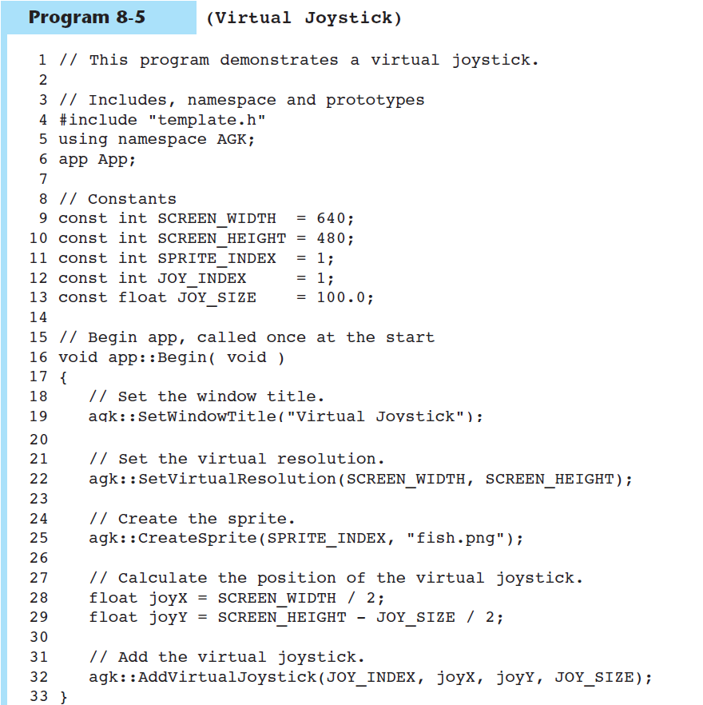
Program 8-5 (VirtualJoystick, part 1/2)

Slide 18
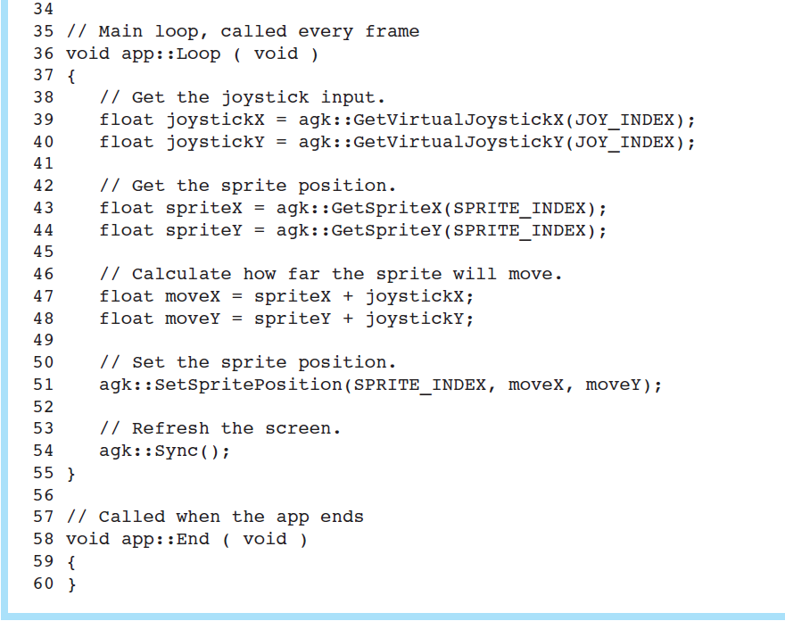
Program 8-5 (VirtualJoystick, part 2/2)

Slide 19
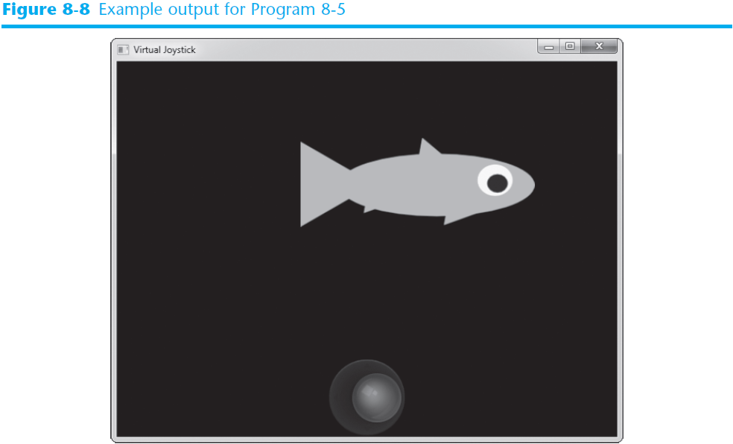

Slide 20
Class Exercise: VirtualJoystick folder in Google Drive
// This program demonstrates a virtual joystick.
// Includes, namespace and prototypes
#include "template.h"
using namespace AGK;
app App;
// Constants
const int SCREEN_WIDTH = 640;
const int SCREEN_HEIGHT = 480;
const int SPRITE_INDEX = 1;
const int JOY_INDEX = 1;
const float JOY_SIZE = 100.0;
// Begin app, called once at the start
void app::Begin( void ){
// Set the window title.
agk::SetWindowTitle("Virtual Joystick");
// Set the virtual resolution.
agk::SetVirtualResolution(SCREEN_WIDTH, SCREEN_HEIGHT);
// Create the sprite.
agk::CreateSprite(SPRITE_INDEX, "fish.png");
// Calculate the position of the virtual joystick.
float joyX = SCREEN_WIDTH / 2;
float joyY = SCREEN_HEIGHT - JOY_SIZE / 2;
// Add the virtual joystick.
agk::AddVirtualJoystick(JOY_INDEX, joyX, joyY, JOY_SIZE);
}
// Main loop, called every frame
void app::Loop ( void ){
// Get the joystick input.
float joystickX = agk::GetVirtualJoystickX(JOY_INDEX);
float joystickY = agk::GetVirtualJoystickY(JOY_INDEX);
// Get the sprite position.
float spriteX = agk::GetSpriteX(SPRITE_INDEX);
float spriteY = agk::GetSpriteY(SPRITE_INDEX);
// Calculate how far the sprite will move.
float moveX = spriteX + joystickX;
float moveY = spriteY + joystickY;
// Set the sprite position.
agk::SetSpritePosition(SPRITE_INDEX, moveX, moveY);
// Refresh the screen.
agk::Sync();
}
// Called when the app ends
void app::End ( void )
{
}

Slide 21
8.4 The Keyboard
How do you move objects with the keyboard arrow keys?
  For the X-axis, call agk::GetDirectionX
  For the Y-axis, call agk::GetDirectionY
    What values do these functions return?
      A floating-point value from -0.9 to 0.9 or 0 if not pressed
    What causes the return values to be different?
      Positive values are returned when pressing down or right
      Negative values are returned when pressing up or left
  Program 8-6, for example

Slide 22
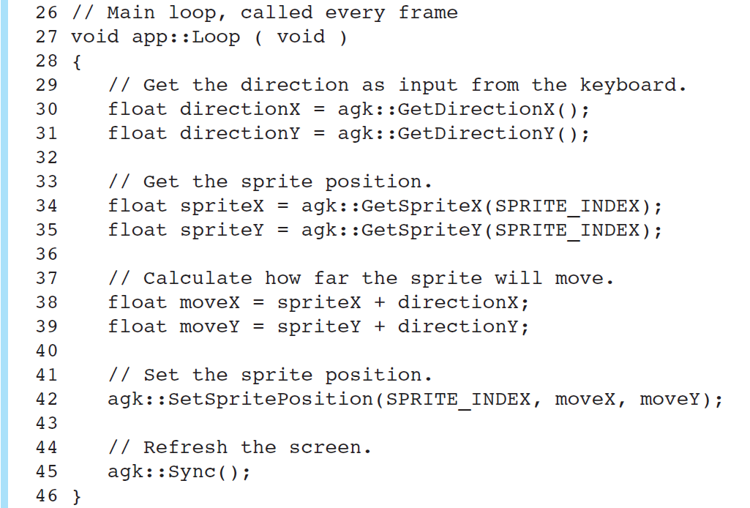
Program 8-6 (DirectionKeys, partial listing)

Slide 23
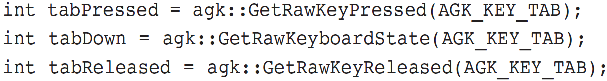
8.4 The Keyboard
  How do you respond to specific key presses?
    Similar to responding to virtual button and mouse presses
    Call any one of the following three functions:
      agk::GetRawKeyPressed (Was the key pressed?)
      agk::GetRawKeyState (Was the key held down?)
      agk::GetRawKeyReleased (Was the key released?)
    All three functions accept a single argument:
      A value (0 – 255) representing the key code for the key
      For example:

Slide 24
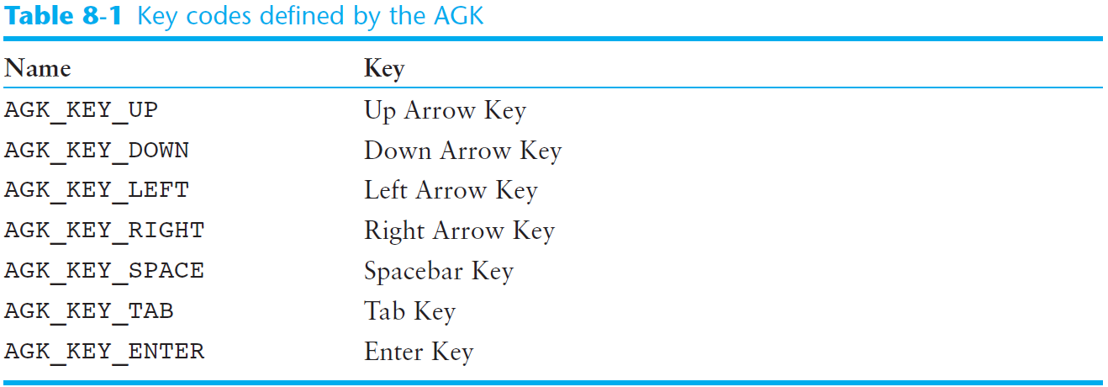
8.4 The Keyboard
  How do you know which key code values to use?
    Many of the key codes are defined by the AGK
      AGK defined key codes start with AGK_KEY_

Slide 25
8.4 The Keyboard
How do you determine the last key that was pressed?
  Call the agk::GetRawLastKey function
    Returns the key code for the last key that was pressed
  Program 8-7, for example

Slide 26
Class Exercise: DirectionKeys folder in Google Drive
// This program demonstrates direction keys.
// Includes, namespace and prototypes
#include "template.h"
using namespace AGK;
app App;
// Constants
const int SCREEN_WIDTH = 640;
const int SCREEN_HEIGHT = 480;
const int SPRITE_INDEX = 1;
// Begin app, called once at the start
void app::Begin( void )
{
// Set the window title.
agk::SetWindowTitle("Direction Keys");
// Set the virtual resolution.
agk::SetVirtualResolution(SCREEN_WIDTH, SCREEN_HEIGHT);
// Create the sprite.
agk::CreateSprite(SPRITE_INDEX, "fish.png");
}
// Main loop, called every frame
void app::Loop ( void )
{
// Get the direction as input from the keyboard.
float directionX = agk::GetDirectionX();
float directionY = agk::GetDirectionY();
// Get the sprite position.
float spriteX = agk::GetSpriteX(SPRITE_INDEX);
float spriteY = agk::GetSpriteY(SPRITE_INDEX);
// Calculate how far the sprite will move.
float moveX = spriteX + directionX;
float moveY = spriteY + directionY;
// Set the sprite position.
agk::SetSpritePosition(SPRITE_INDEX, moveX, moveY);
// Refresh the screen.
agk::Sync();
}
// Called when the app ends
void app::End ( void )
{
}

Slide 27
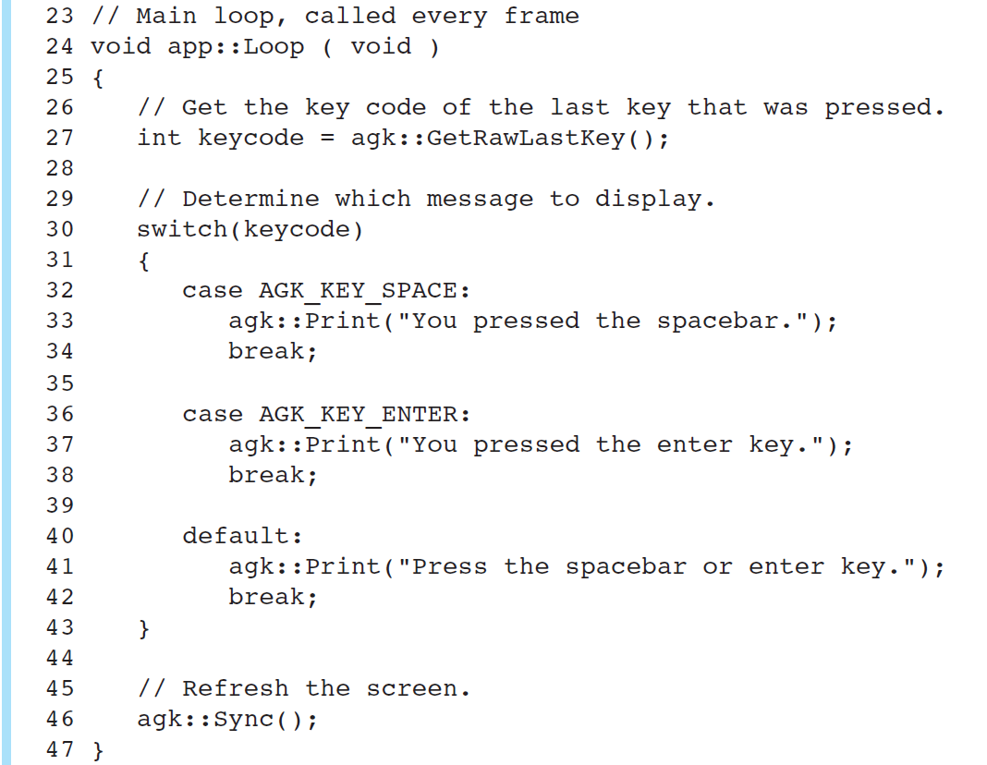
Program 8-7 (LastKeyPressed, partial listing)

Slide 28
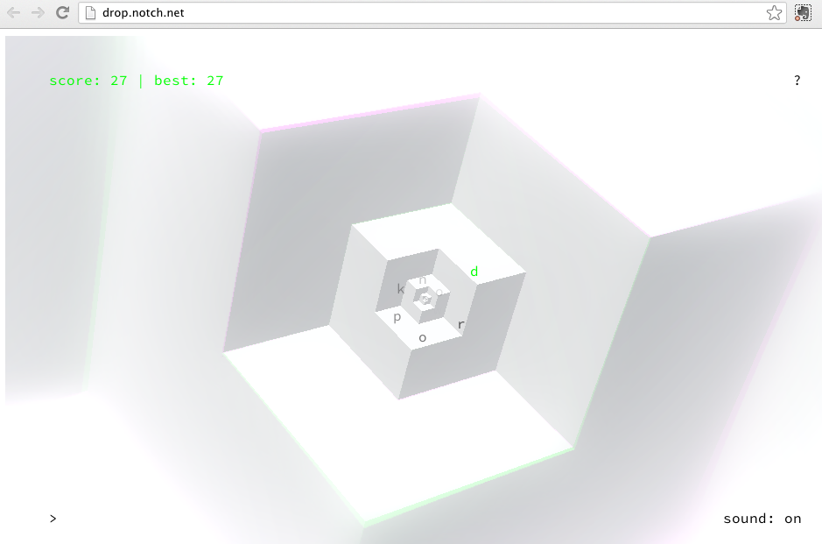
Woah crazy online game using Unity Web Player!! (http://unity3d.com/webplayer/)

Slide 29
Class Templates vs. Function Templates

Slide 30
Function Templates
Function template: a pattern for a function that can work with many data types
When written, parameters are left for the data types
When called, compiler generates code for specific data types in function call

Slide 31
Function Template Example
template
prefix
  template <class T>
  T times10(T num)
  {
  return 10 * num;
  }
generic
data type
type
parameter
What gets generated when times10 is called with an int: | What gets generated when times10 is called with a double:
int times10(int num) { return 10 * num; } | double times10(double num) { return 10 * num; }

Slide 32
Function Template Example
  template <class T>
  T times10(T num)
  {
  return 10 * num;
  }
Call a template function in the usual manner:
  int ival = 3;
  double dval = 2.55;
  cout << times10(ival); // displays 30
  cout << times10(dval); // displays 25.5

Slide 33
Function Template Notes
Can define a template to use multiple data types:
template<class T1, class T2>
Example:
  template<class T1, class T2> // T1 and T2 will be
  double mpg(T1 miles, T2 gallons) // replaced in the
  { // called function
  return miles / gallons // with the data
  } // types of the
  // arguments

Slide 34
Function Template Notes
Function templates can be overloaded Each template must have a unique parameter list
  template <class T>
  T sumAll(T num) ...
  template <class T1, class T2>
  T1 sumall(T1 num1, T2 num2) ...

Slide 35
Function Template Notes
All data types specified in template prefix must be used in template definition
Function calls must pass parameters for all data types specified in the template prefix
Like regular functions, function templates must be defined before being called

Slide 36
Function Template Notes
A function template is a pattern
No actual code is generated until the function named in the template is called
A function template uses no memory
When passing a class object to a function template, ensure that all operators in the template are defined or overloaded in the class definition

Slide 37
Where to Start
When Defining Templates
Templates are often appropriate for multiple functions that perform the same task with different parameter data types
Develop function using usual data types first, then convert to a template:
  add template prefix
  convert data type names in the function to a type parameter (i.e., a T type) in the template

Slide 38
Class Templates
Classes can also be represented by templates. When a class object is created, type information is supplied to define the type of data members of the class.
Unlike functions, classes are instantiated by supplying the type name (int, double, string, etc.) at object definition

Slide 39
Class Template Example
  template <class T>
  class grade
  {
  private:
  T score;
  public:
  grade(T);
  void setGrade(T);
  T getGrade()
  };

Slide 40
Class Template Example
Pass type information to class template when defining objects:
  grade<int> testList[20];
  grade<double> quizList[20];
Use as ordinary objects once defined

Slide 41
Class Templates and Inheritance
Class templates can inherit from other class templates:
  template <class T>
  class Rectangle
  { ... };
  template <class T>
  class Square : public Rectangle<T>
  { ... };
Must use type parameter T everywhere base class name is used in derived class

Slide 42
More Details of the Standard Template Library

Slide 43
Standard Template Library
Two important types of data structures in the STL:
  containers: classes that stores data and imposes some organization on it
  iterators: like pointers; mechanisms for accessing elements in a container

Slide 44
Containers
Two types of container classes in STL:
  sequence containers: organize and access data sequentially, as in an array. These include vector, dequeue, and list
  associative containers: use keys to allow data elements to be quickly accessed. These include set, multiset, map, and multimap

Slide 45
Iterators
Generalization of pointers, used to access information in containers
Four types:
  forward (uses ++)
  bidirectional (uses ++ and -- )
  random-access
  input (can be used with cin and istream objects)
  output (can be used with cout and ostream objects)

Slide 46
Algorithms
STL contains algorithms implemented as function templates to perform operations on containers.
Requires algorithm header file
algorithm includes
binary_search | count
for_each | find
find_if | max_element
min_element | random_shuffle
sort | and others

Slide 47
Exceptions to the norm
Exceptions in C++

Slide 48
Exceptions
Indicate that something unexpected has occurred or been detected
Allow program to deal with the problem in a controlled manner
Can be as simple or complex as program design requires

Slide 49
Exceptions - Terminology
Exception: object or value that signals an error
Throw an exception: send a signal that an error has occurred
Catch/Handle an exception: process the exception; interpret the signal

Slide 50
Exceptions – Key Words
throw – followed by an argument, is used to throw an exception
try – followed by a block { }, is used to invoke code that throws an exception
catch – followed by a block { }, is used to detect and process exceptions thrown in preceding try block. Takes a parameter that matches the type thrown.

Slide 51
Exceptions – Flow of Control
A function that throws an exception is called from within a try block
If the function throws an exception, the function terminates and the try block is immediately exited. A catch block to process the exception is searched for in the source code immediately following the try block.
If a catch block is found that matches the exception thrown, it is executed. If no catch block that matches the exception is found, the program terminates.

Slide 52
Exceptions – Example (1)
// function that throws an exception
int totalDays(int days, int weeks)
{
if ((days < 0) || (days > 7))
throw "invalid number of days";
// the argument to throw is the
// character string
else
return (7 * weeks + days);
}

Slide 53
Exceptions – Example (2)
try // block that calls function
{
totDays = totalDays(days, weeks);
cout << "Total days: " << days;
}
catch (char *msg) // interpret // exception
{
cout << "Error: " << msg;
}

Slide 54
Exceptions – What Happens
try block is entered. totalDays function is called
If 1st parameter is between 0 and 7, total number of days is returned and catch block is skipped over (no exception thrown)
If exception is thrown, function and try block are exited, catch blocks are scanned for 1st one that matches the data type of the thrown exception. catch block executes

Slide 55
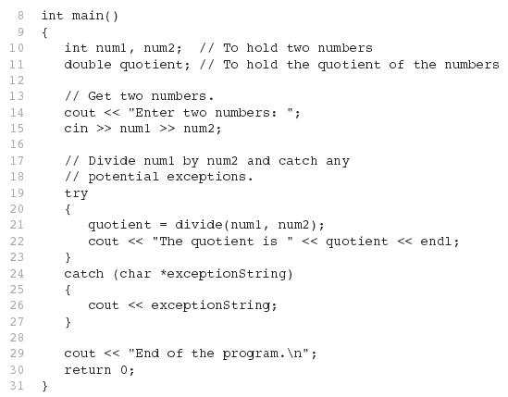
From Program 16-1

Slide 56
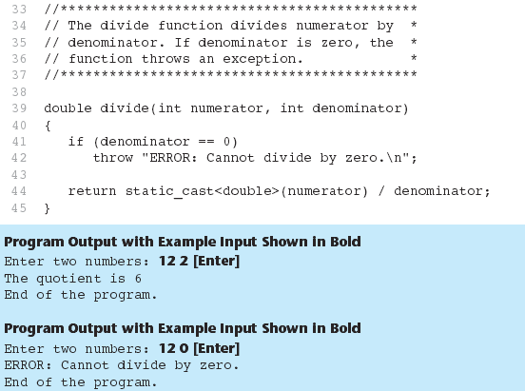
From Program 16-1

Slide 57
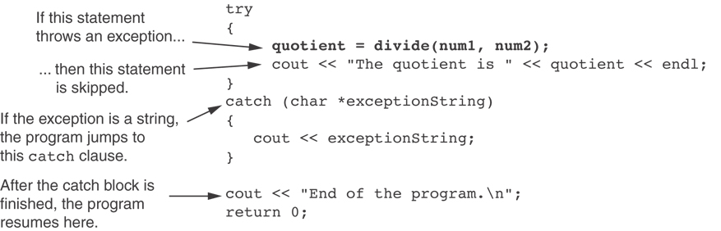
What Happens in theTry/Catch Construct

Slide 58
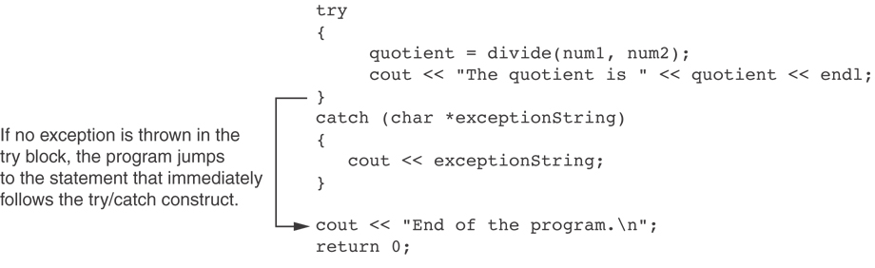
What if no exception is thrown?

Slide 59
Exceptions - Notes
Predefined functions such as new may throw exceptions
The value that is thrown does not need to be used in catch block.
  in this case, no name is needed in catch parameter definition
  catch block parameter definition does need the type of exception being caught

Slide 60
Exception Not Caught?
An exception will not be caught if
  it is thrown from outside of a try block
  there is no catch block that matches the data type of the thrown exception
If an exception is not caught, the program will terminate

Slide 61
Exceptions and Objects
An exception class can be defined in a class and thrown as an exception by a member function
An exception class may have:
  no members: used only to signal an error
  members: pass error data to catch block
A class can have more than one exception class

Slide 62
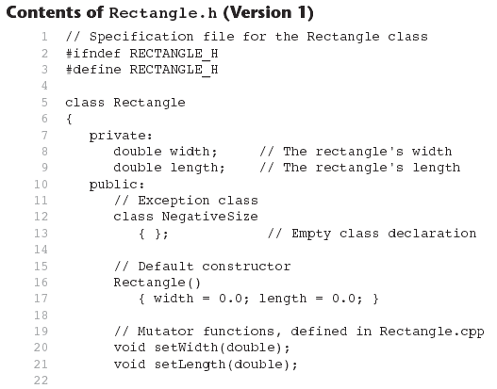

Slide 63
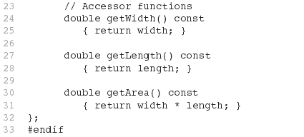
Contents of Rectangle.h (Version1) (Continued)

Slide 64
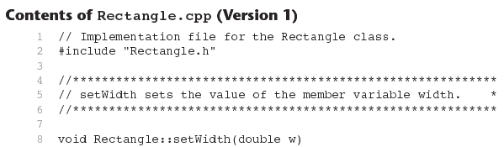
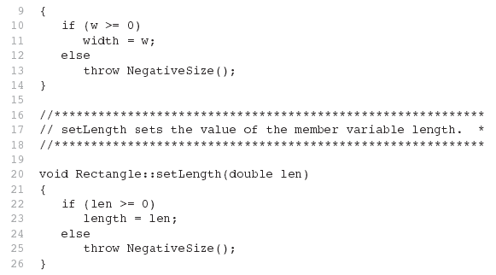

Slide 65
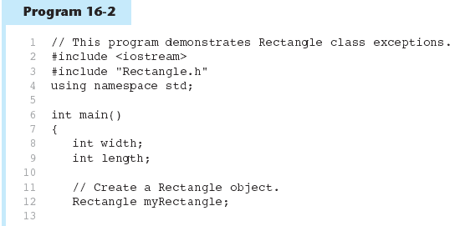

Slide 66
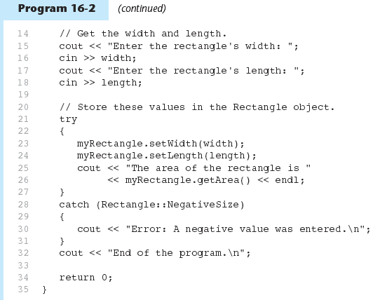

Slide 67
// Implementation file for the Rectangle class.
#include "Rectangle.h"
//***********************************************************
// setWidth sets the value of the member variable width. *
//***********************************************************
void Rectangle::setWidth(double w)
{
if (w >= 0)
width = w;
else
throw NegativeSize();
}
//***********************************************************
// setLength sets the value of the member variable length. *
//***********************************************************
void Rectangle::setLength(double len)
{
if (len >= 0)
length = len;
else
throw NegativeSize();
}
Class Exercise: Rectangle exceptions
Folder “Rectangle Version 1” in Google Drive
// This program demonstrates Rectangle class exceptions.
#include <iostream>
#include "Rectangle.h"
using namespace std;
int main()
{
int width;
int length;
// Create a Rectangle object.
Rectangle myRectangle;
// Get the width and length.
cout << "Enter the rectangle's width: ";
cin >> width;
cout << "Enter the rectangle's length: ";
cin >> length;
// Store these values in the Rectangle object.
try
{
myRectangle.setWidth(width);
myRectangle.setLength(length);
cout << "The area of the rectangle is "
<< myRectangle.getArea() << endl;
}
catch (Rectangle::NegativeSize)
{
cout << "Error: A negative value was entered.\n";
}
cout << "End of the program.\n";
return 0;
}
// Specification file for the Rectangle class
#ifndef RECTANGLE_H
#define RECTANGLE_H
class Rectangle
{
private:
double width; // The rectangle's width
double length; // The rectangle's length
public:
// Exception class
class NegativeSize
{ }; // Empty class declaration
// Default constructor
Rectangle()
{ width = 0.0; length = 0.0; }
// Mutator functions, defined in Rectangle.cpp
void setWidth(double);
void setLength(double);
// Accessor functions
double getWidth() const
{ return width; }
double getLength() const
{ return length; }
double getArea() const
{ return width * length; }
};
#endif

Slide 68
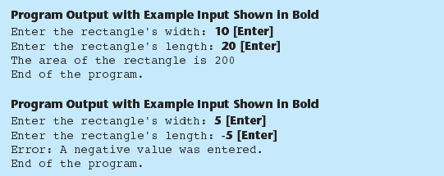
Program 16-2 (Continued)

Slide 69
What Happens After catch Block?
Once an exception is thrown, the program cannot return to throw point. The function executing throw terminates (does not return), other calling functions in try block terminate, resulting in unwinding the stack
If objects were created in the try block and an exception is thrown, they are destroyed.

Slide 70
Nested try Blocks
try/catch blocks can occur within an enclosing try block
Exceptions caught at an inner level can be passed up to a catch block at an outer level:
  catch ( )
  {
  ...
  throw; // pass exception up
  } // to next level

Slide 71


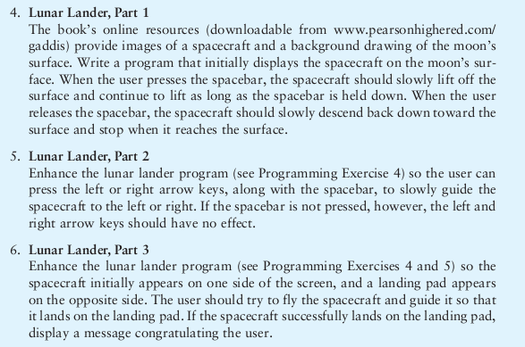
HW for Monday (pick 2)
Lunar Lander media are in folder “Space-HW-Media”
On Google Drive
1)
2)
3)

Slide 72
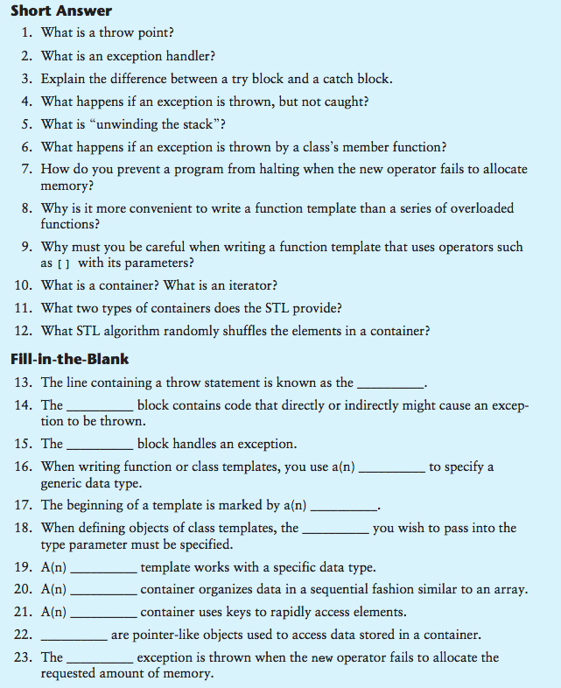
3)
4)

Slide 73
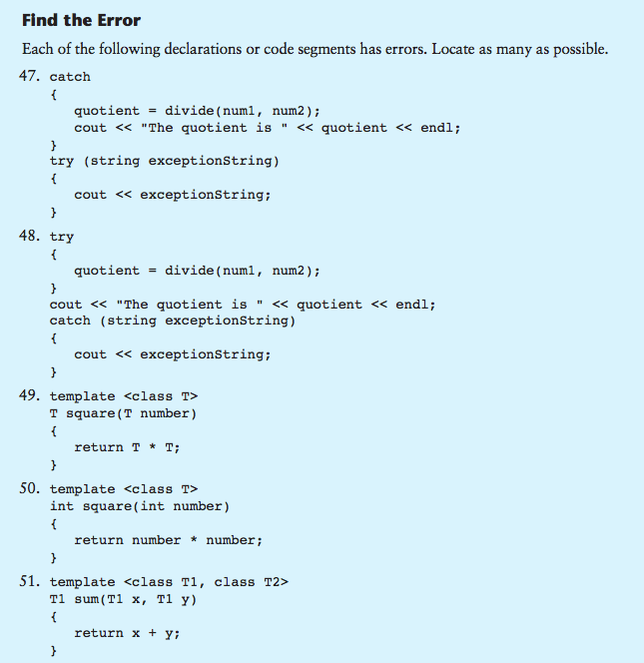
5)
6)
Write a class that handles a GamePlayer, or lunar lander exception, like the
rectangle exception in class.

